Slide 1

Spectroscopy Ninja
Optical Spectroscopy Software Development
© 2019: Dr. Friedrich Menges Software-Entwicklung. Friedrich.menges@effemm2.de Web: http://spectroscopy.ninja All rights reserved.

Slide 2

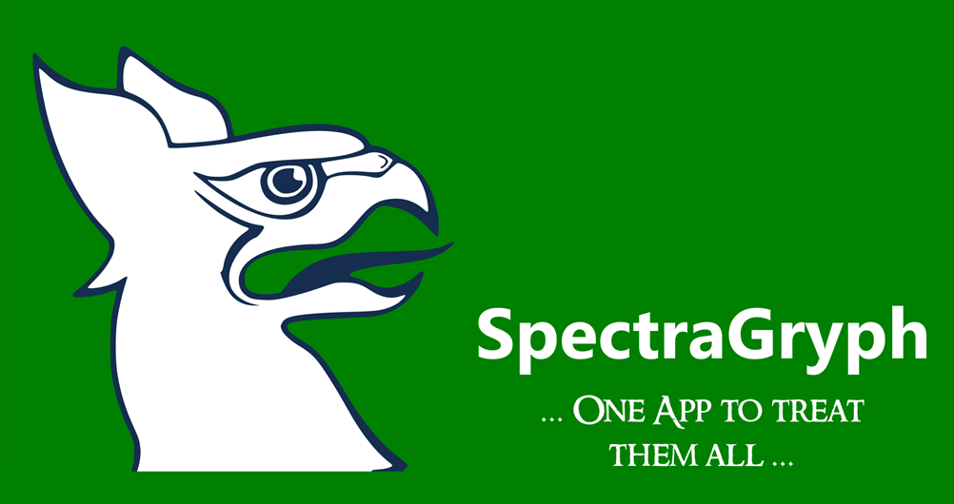
Proudly presenting:
About
10 pages
Features
22 pages
Testimonials
2 pages
Links
(1 page)
Applications
(3 pages, growing)
© 2019: Dr. Friedrich Menges Software-Entwicklung. Friedrich.menges@effemm2.de Web: http://spectroscopy.ninja All rights reserved.

Slide 3
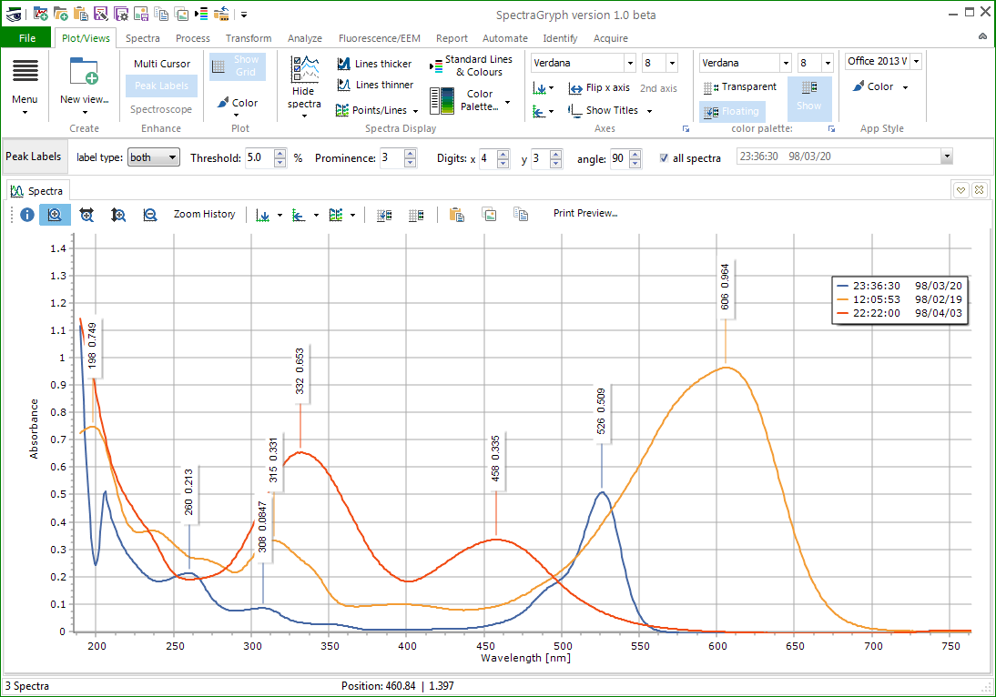
What it is:
Universal software for optical spectra processing
Easy to use
Rock solid
Lean
Free for private
& academic use
(in standard version)
© 2019: Dr. Friedrich Menges Software-Entwicklung. Friedrich.menges@effemm2.de Web: http://spectroscopy.ninja All rights reserved.

Slide 4
What it improves:
Frees the data from the instrument computer
Brings all kind of spectra together
To visualize/ analyze multiple spectra at once
One processing solution for all file formats
© 2019: Dr. Friedrich Menges Software-Entwicklung. Friedrich.menges@effemm2.de Web: http://spectroscopy.ninja All rights reserved.

Slide 5
What it does:
Open UV-VIS, NIR, FTIR, Raman, fluorescence, LIBS, XRF
70 file formats recognized
View, analyze, process & convert many spectra in parallel
Automated batch processing with predefined sequence
Spectral database search & matching
Live spectra acquisition & spectrometer control
© 2019: Dr. Friedrich Menges Software-Entwicklung. Friedrich.menges@effemm2.de Web: http://spectroscopy.ninja All rights reserved.

Slide 6
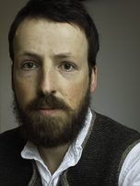
Who does it:
Dr. Friedrich Menges
studied chemistry 1993-1999
2000 – 2005: PhD in physical chemistry
2005-2010 device developer for minia-
turized/ microfluidic bioanalytical systems
2010-2016: R&D system engineer (Tecan/Salzburg), developing multi-mode microplate readers
Since June 01, 2016: full-time with Spectroscopy Ninja
2000 – now: spectroscopy software development
© 2019: Dr. Friedrich Menges Software-Entwicklung. Friedrich.menges@effemm2.de Web: http://spectroscopy.ninja All rights reserved.

Slide 7
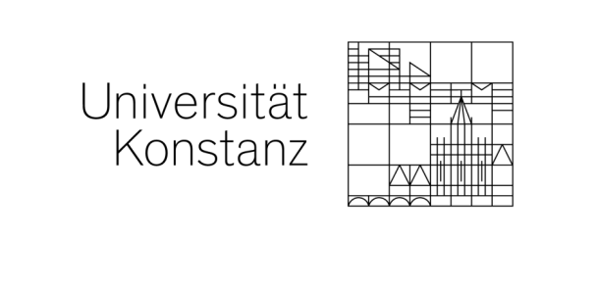
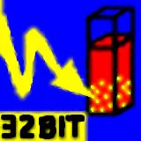
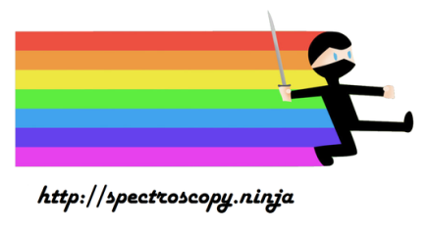

Where it comes from:
2000 – 2005: PhD at Universität Konstanz
initially: Spekwin32 as tool for internal use
late 2002: first web site
03/2004 : english version
2010: dual use conditions, trade license
08/2014: creation of Spectroscopy Ninja
June 01, 2016: full-time with
Spectroscopy Ninja (as a single person)
Nov 11, 2016: release of Spectragryph as
modernized, enhanced successor software
for the outdated Spekwin32
© 2019: Dr. Friedrich Menges Software-Entwicklung. Friedrich.menges@effemm2.de Web: http://spectroscopy.ninja All rights reserved.

Slide 8
Where it is g(r)o(w)ing to:
as of 12/2019:
42,000 downloads since first release
25 software updates released
3 major areas added (identification, automation, acquisition)
30 new file formats recognized
© 2019: Dr. Friedrich Menges Software-Entwicklung. Friedrich.menges@effemm2.de Web: http://spectroscopy.ninja All rights reserved.

Slide 9


What to pay for it:
Spectragryph variant | Non- commercial use | Academic distribution | Commercial use
Spectragryph standard version | Free | € 500 | € 290
Spectragryph-on modular spectrometer control | € 125 | € 2900 | € 590
Spectragryph-id unlimited spectral database search | € 200 | € 4400 | € 790
Spectragryph-id-on database search & spectrometer control | € 290 | € 6500 | € 990
Licenses are valid forever with no recurring costs, include all future updates!
© 2019: Dr. Friedrich Menges Software-Entwicklung. Friedrich.menges@effemm2.de Web: http://spectroscopy.ninja All rights reserved.

Slide 10
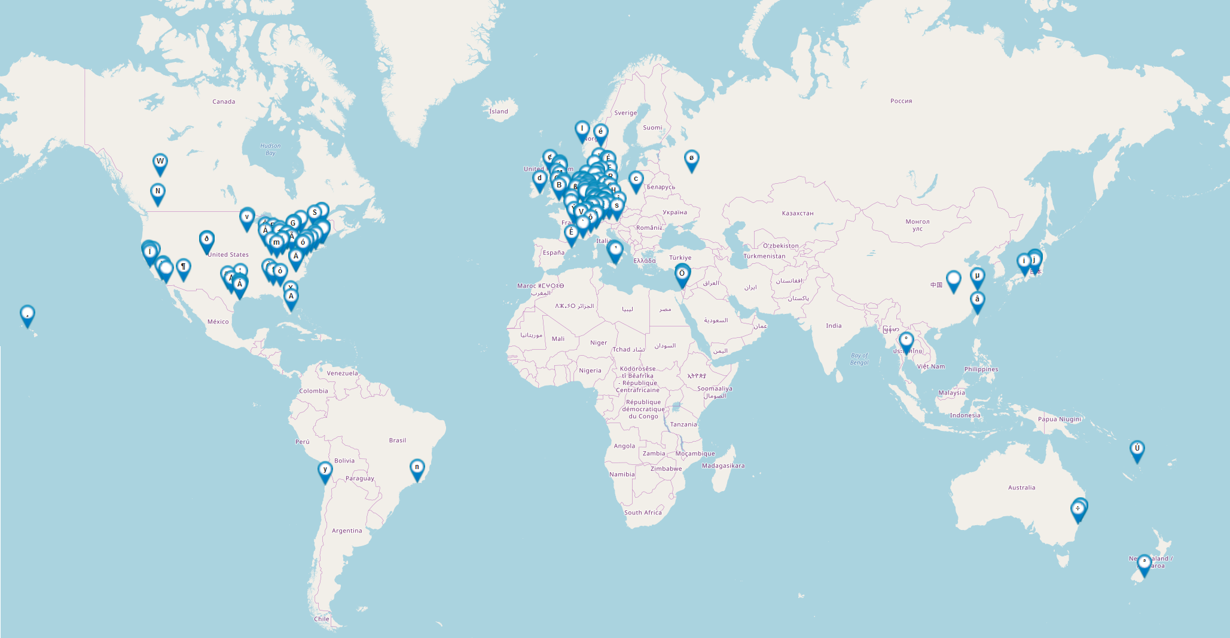
Who paid for it:
© 2019: Dr. Friedrich Menges Software-Entwicklung. Friedrich.menges@effemm2.de Web: http://spectroscopy.ninja All rights reserved.

Slide 11
Which industries:
Optics, Lasers, Spectroscopy
Analytical Instrumentation
Chemicals, Materials
Pharmaceuticals
Life Sciences, Medical Devices
Oil & Lubricants
Mining, Exploration, Geology
Gemmology, Gem Appraisal
Arts & Conservation
& Academia, of course!
(>200 Spectragryph citations, 450 alltogether)
© 2019: Dr. Friedrich Menges Software-Entwicklung. Friedrich.menges@effemm2.de Web: http://spectroscopy.ninja All rights reserved.

Slide 12
Features: overview
User interface
Main window
Plot view
Spectra display
Data in/out
File formats
Process:
baseline
Process: smoothing
Process:
scaling
Process:
removal
Process: chemometrics
Transform
Transform:
new types
Analyze:
peaks, integrals
Analyze: calculations
Analyze:
extract data
Fluorescence/EEM
Automate
Identify:
database creation
Identify:
search results
Acquire
© 2019: Dr. Friedrich Menges Software-Entwicklung. Friedrich.menges@effemm2.de Web: http://spectroscopy.ninja All rights reserved.

Slide 13
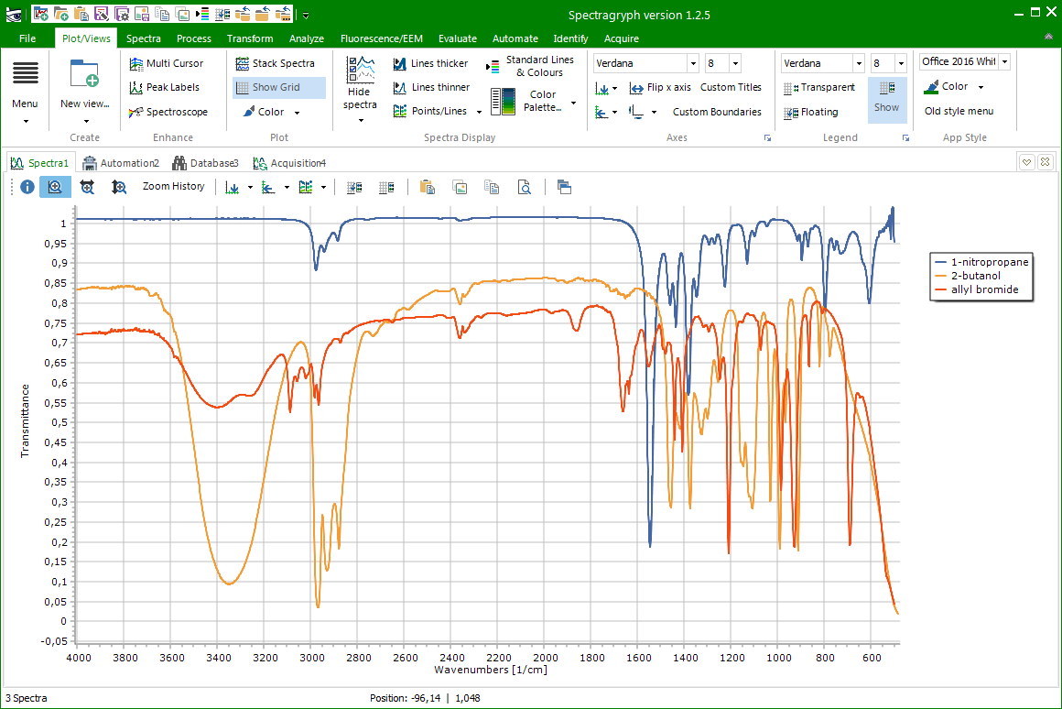
Features: user interface
one main window: the plot
arranged in browser-like tabs
special tab types: EEM, identification, automation, acquisition
ribbons
tabs
interactive legend box
plots
© 2019: Dr. Friedrich Menges Software-Entwicklung. Friedrich.menges@effemm2.de Web: http://spectroscopy.ninja All rights reserved.

Slide 14
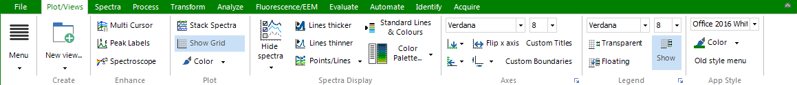
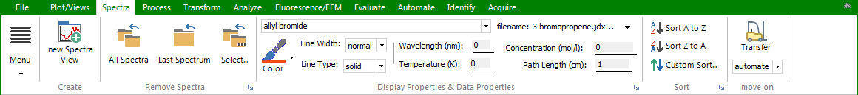
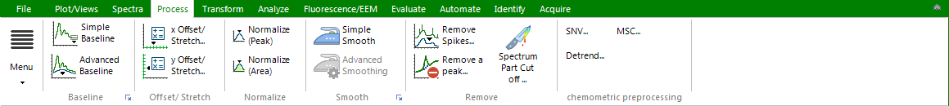
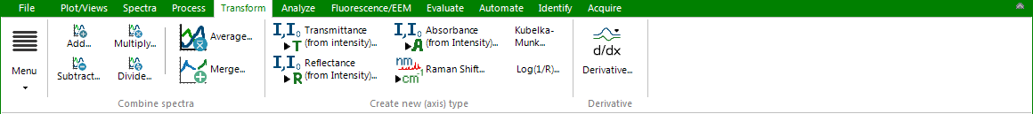
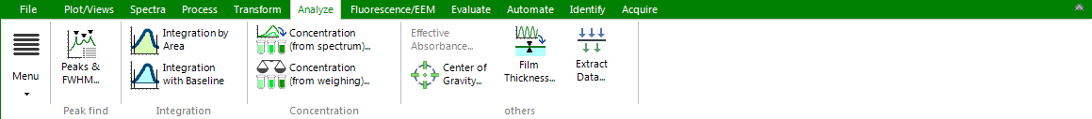
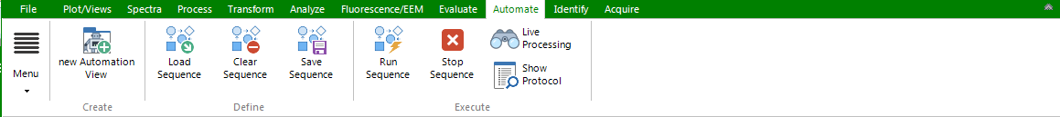
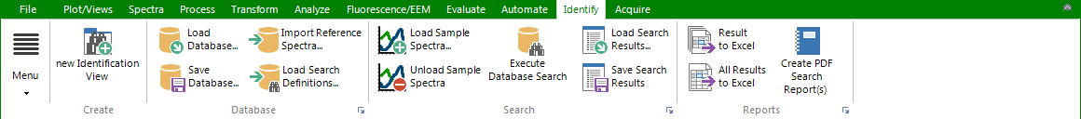
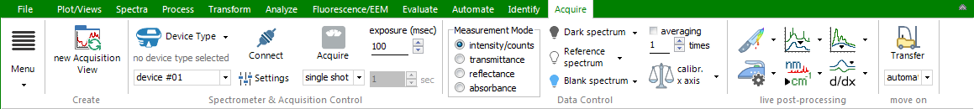
Features: ribbons
All functions organized in ribbons (like Word, Excel, …)
special ribbons for special function areas
© 2019: Dr. Friedrich Menges Software-Entwicklung. Friedrich.menges@effemm2.de Web: http://spectroscopy.ninja All rights reserved.

Slide 15
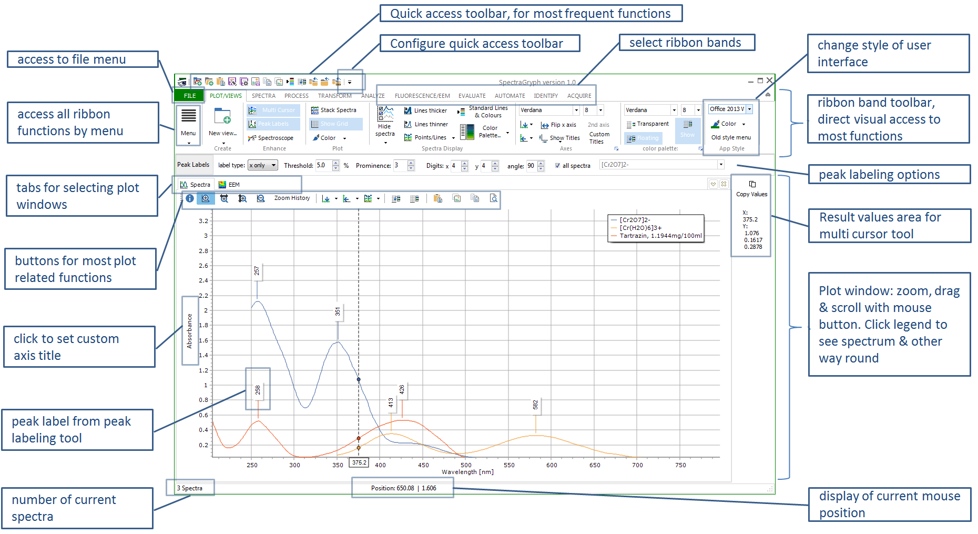
Features: all main window functions
© 2019: Dr. Friedrich Menges Software-Entwicklung. Friedrich.menges@effemm2.de Web: http://spectroscopy.ninja All rights reserved.

Slide 16


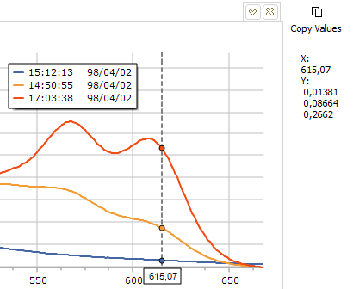
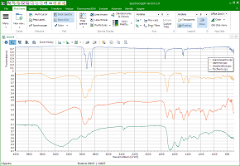
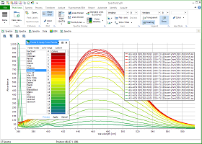
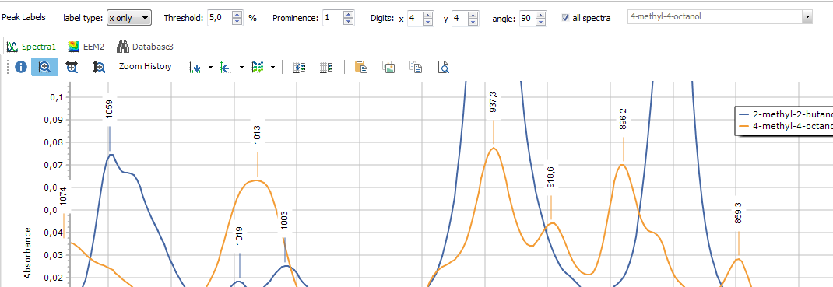
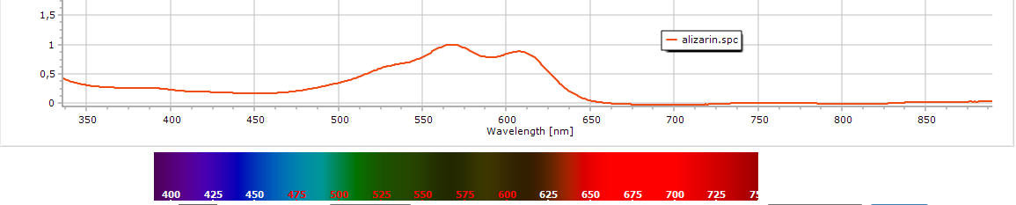
Features: controlling plot view
On-the-fly x, y axis transformation
Show/hide spectra, legend, grid, peak labels
Select colour schemes, line thickness, text properties
Set custom axis labels, locked axis ranges
Zoom, unzoom, pan, scroll plot with mouse
Stack spectra
Special functions:
- multi-cursor
- spectroscope view
© 2019: Dr. Friedrich Menges Software-Entwicklung. Friedrich.menges@effemm2.de Web: http://spectroscopy.ninja All rights reserved.

Slide 17
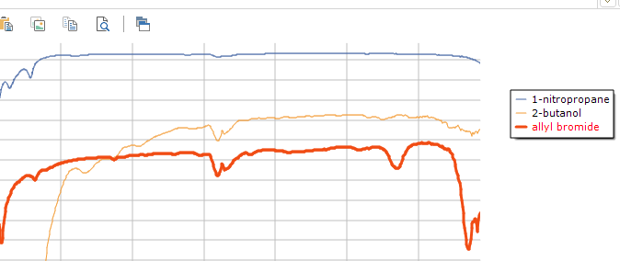
Features: controlling spectra display
Set individual line properties, color
Set spectrum properties, legend text (F6 short key)
Sort A→Z or vice versa
Select indiv. spectra from ribbon
Click legende text to highlight spectrum (& vice versa)
Shift&scale individual spectra
Undo
Delete all, last or a selection
CTRL+Click on spectrum
for direct delete
© 2019: Dr. Friedrich Menges Software-Entwicklung. Friedrich.menges@effemm2.de Web: http://spectroscopy.ninja All rights reserved.

Slide 18
Features: data input/output
Open all recognized file formats with File→Open
Drag&drop files into plot window from explorer
Copy&paste data columns from Excel or text editor
➔ will be recognized as spectrum plot
Save spectra as 8 data formats (spc, dx, nir, csv, dat, sgd, spv, rruff)
Batch export all spectra into 5 file formats
Copy data tables to clipboard
Save plot as 7 picture formats (bmp, emf, eps, pdf, png, svg, wmf)
Copy plot picture to clipboard (as vector graphics)
© 2019: Dr. Friedrich Menges Software-Entwicklung. Friedrich.menges@effemm2.de Web: http://spectroscopy.ninja All rights reserved.

Slide 19






























Features: file formats
Reading original binary files & exported spectral data from these manufacturers:
AIT/ Analect
© 2019: Dr. Friedrich Menges Software-Entwicklung. Friedrich.menges@effemm2.de Web: http://spectroscopy.ninja All rights reserved.

Slide 20
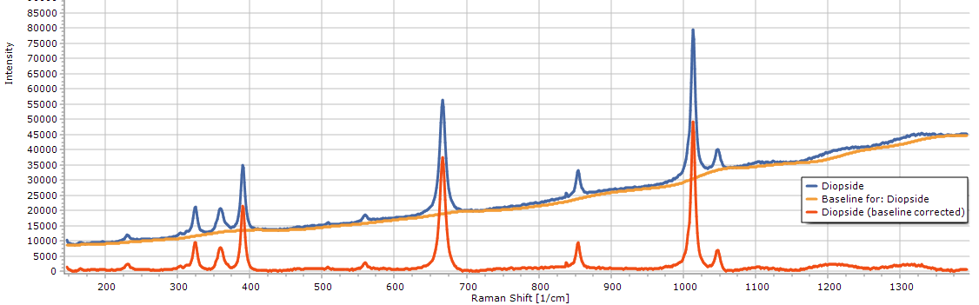
Features: Process (baselines)
Simple baseline: bring straight horizontal baseline down to zero (mainly UV-VIS, also Raman, LIBS)
Advanced baseline: interactive baseline definition
  linear: a linear baseline with variable slope & offset
  adaptive: snuggling a curved baseline to spectrum bottom, best for Raman (fluorescence removal), FTIR, LIBS
  scattering: mimicking a turbid solution‘s exponential baseline increase towards short wavelengths (UV-VIS only)
© 2019: Dr. Friedrich Menges Software-Entwicklung. Friedrich.menges@effemm2.de Web: http://spectroscopy.ninja All rights reserved.

Slide 21
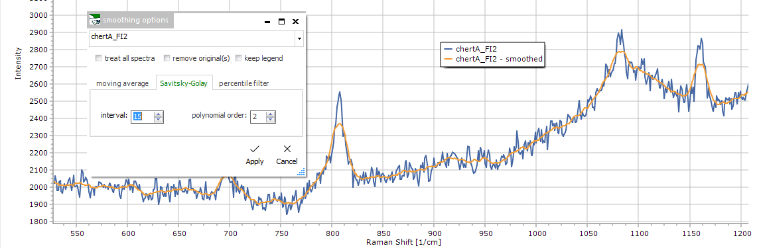
Features: Process (smoothing)
Simple smoothing: with a Savitsky-Golay filter of medium strength, no settings
Advanced smoothing: 4 algorithms with settings
  Moving average: interval size, averaging function (rect. / triang.)
  Savitsky-Golay: interval size, polynomial order (2nd – 5th)
  Percentile filter: interval size, percentile (0 – 100%)
  Baseline selective: vertical gradient, % of spectrum
© 2019: Dr. Friedrich Menges Software-Entwicklung. Friedrich.menges@effemm2.de Web: http://spectroscopy.ninja All rights reserved.

Slide 22
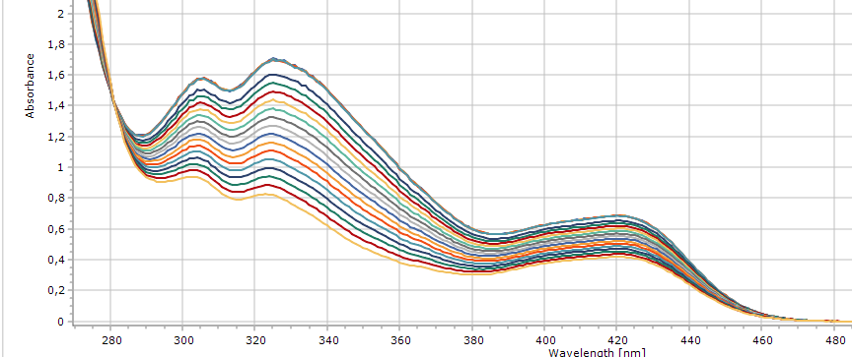
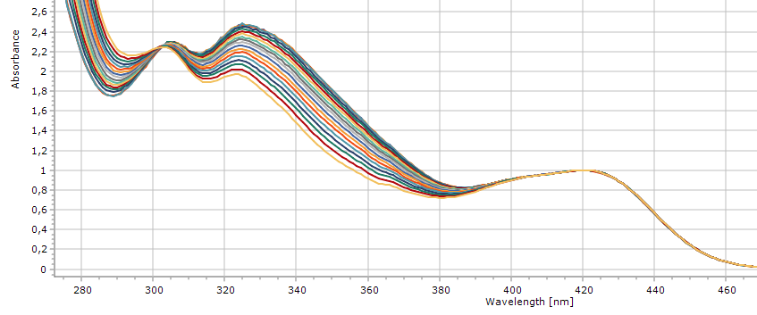
Features: Process (axes based)
x Offset / Stretch: apply addition, subtraction, multiplication, division upon x axis values
y Offset / Stretch: same upon y axis values
Normalize (Peak):
scale spectra, so that highest visible peak = 1
Normalize (area):
scale spectra, so that area under peak is the same
Normalize (value):
scale spectra to certain y value at certain x position
© 2019: Dr. Friedrich Menges Software-Entwicklung. Friedrich.menges@effemm2.de Web: http://spectroscopy.ninja All rights reserved.

Slide 23
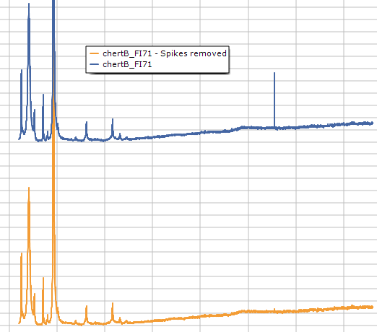
Features: Process (removals)
Remove Spikes: removal of cosmic
spikes, maximal width can be set.
Useful for Raman, fluorescence
(with long exp. times on
Si-based detectors)
Remove a peak:
interpolate at a given position
Spectrum part cut off:
remove spectrum parts from both sides (start + end)
© 2019: Dr. Friedrich Menges Software-Entwicklung. Friedrich.menges@effemm2.de Web: http://spectroscopy.ninja All rights reserved.

Slide 24
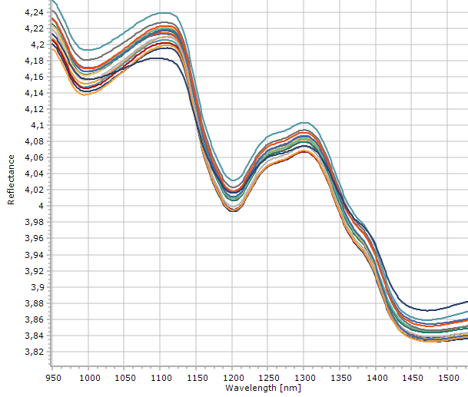
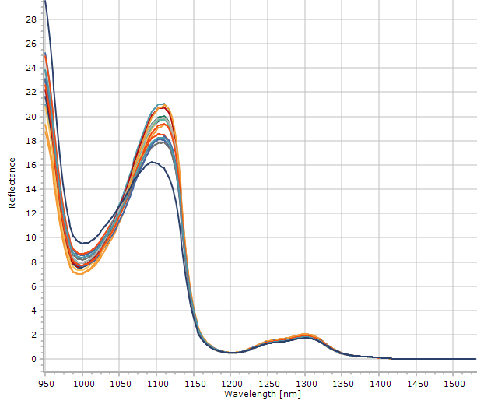
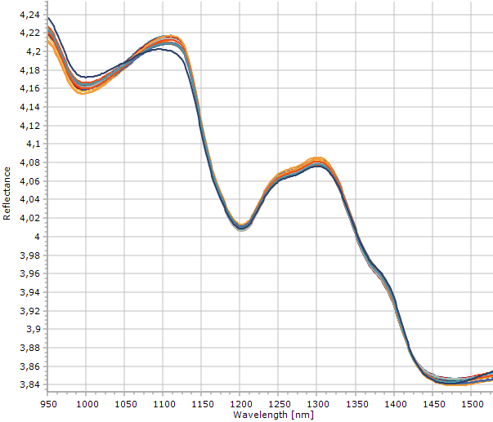
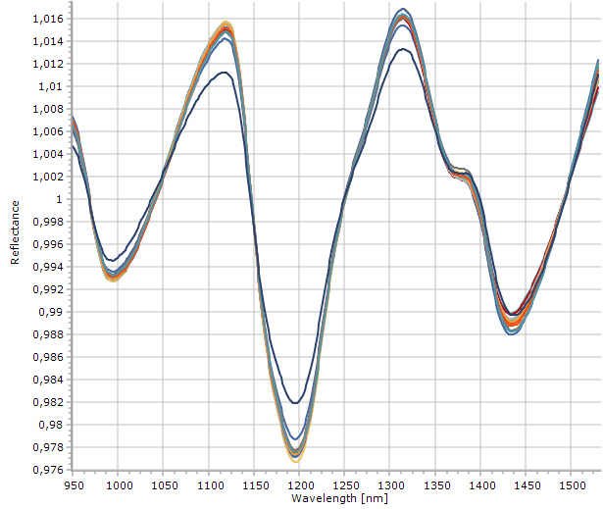
Features: Process (chemometr.)
Variability removal is often required in preprocessing of NIR spectrum series for chemometric applications
SNV: standard normal variates
MSC: multiplicative scatter correction
Detrending: baseline detrending by subtracting polynom. fit
original
SNV
MSC
Detrending
© 2019: Dr. Friedrich Menges Software-Entwicklung. Friedrich.menges@effemm2.de Web: http://spectroscopy.ninja All rights reserved.

Slide 25
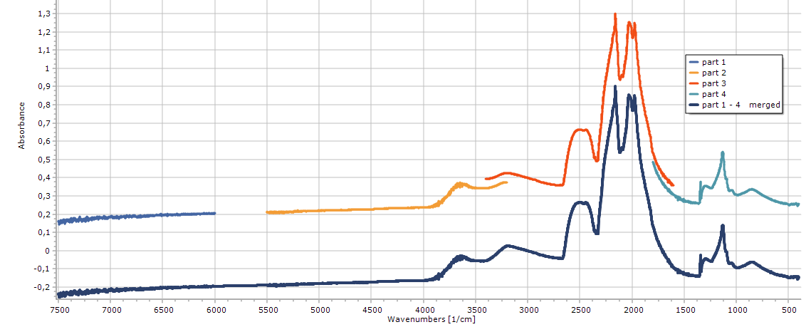
Features: Transform
Apply addition, subtraction, multiplication, division on spectra
Interactive scaled subtraction
Average a selection of spectra (selection rule set available)
Merge a selection of spectra (selection rule set available)
Interpolate, resample to new start/end value, step width
Calculate 1st - 4th derivative, optional internal smoothing
merging function
© 2019: Dr. Friedrich Menges Software-Entwicklung. Friedrich.menges@effemm2.de Web: http://spectroscopy.ninja All rights reserved.

Slide 26
Features: Transform (new types)
To create new spectrum types from given raw data:
Y AXIS:
Transmittance T = I / I₀ ; Reflectance R = I / I₀ (I: intensity)
Absorbance A = -1 * log₁₀( T )
Kubelka-Munk K/S = (1 - R)²/(2 * R)
Log(1/R): just this, for reflectance spectra
X AXIS:
Raman shift R = 10⁷ * (1/λ_{laser} – 1/λ), while R in cm⁻¹
Apply calibration, for Pixels ➔Wavelength, Wavenumbers
© 2019: Dr. Friedrich Menges Software-Entwicklung. Friedrich.menges@effemm2.de Web: http://spectroscopy.ninja All rights reserved.

Slide 27
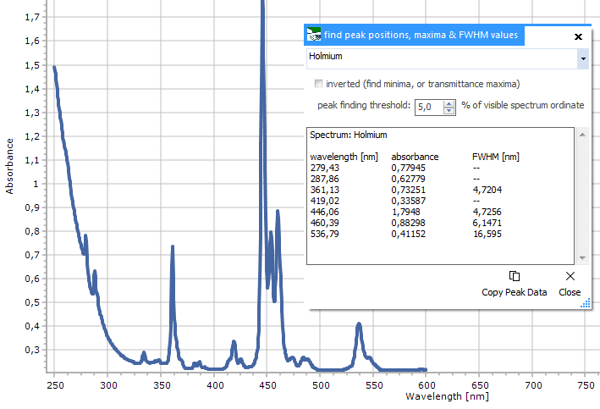
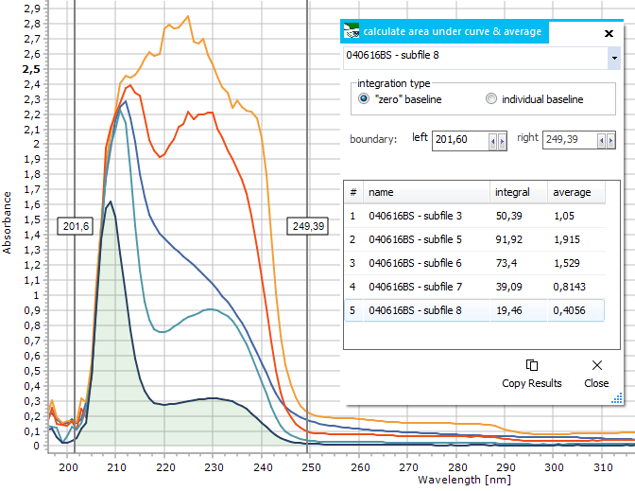
Features: Analyze (peaks, integrals)
Peaks & FWHM:
create a listing of peak positions
& FWHM values & atomic emission
line assignments (LIBS, XRF, Gamma)
Integration by Area: create list of areas
under peak for a defined x range
(straigth baseline at zero)
Integration with baseline: create a list
of areas under peak for a defined x
range (sloped, individual baseline)
Center of gravity: weighted
© 2019: Dr. Friedrich Menges Software-Entwicklung. Friedrich.menges@effemm2.de Web: http://spectroscopy.ninja All rights reserved.

Slide 28
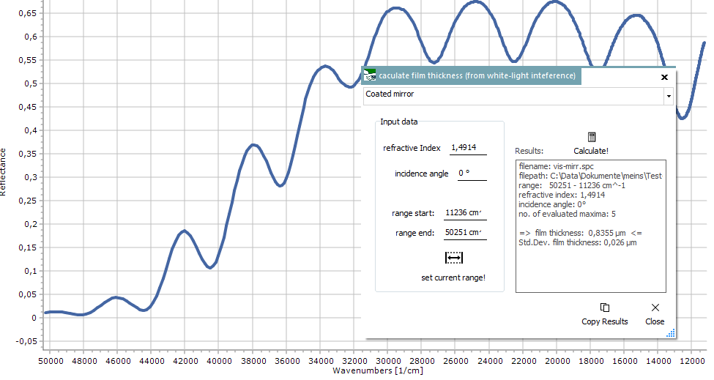

Features: Analyze (calculations)
Concentration: (from spectrum): for UV-VIS spectra, use Lambert-Beer to calc. concentration values
E = ε * c * d ⇔ c = E / ( ε * d)
Concentration: (from weighing): calc. concentration values from sample weight, molecular mass and solvent volume
Film thickness: calculated from fringes of white light inter-ference spectrum. Input values:
refractive index, incident angle,
x axis range.
© 2019: Dr. Friedrich Menges Software-Entwicklung. Friedrich.menges@effemm2.de Web: http://spectroscopy.ninja All rights reserved.

Slide 29
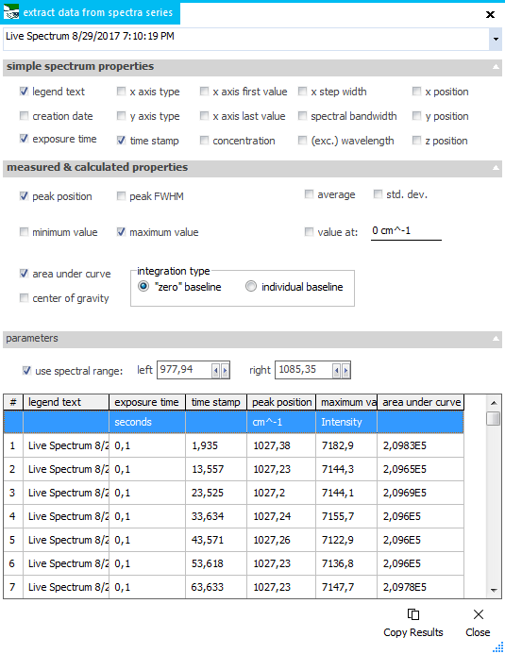
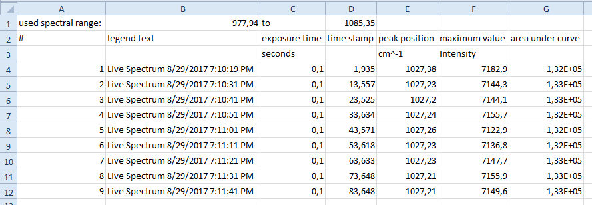
Features: Analyze (extract data)
Extract spectrum properties and calculated values for a series of spectra.
Interactively define x axis range.
Select from 24 parameters.
Copy results list to clipboard
© 2019: Dr. Friedrich Menges Software-Entwicklung. Friedrich.menges@effemm2.de Web: http://spectroscopy.ninja All rights reserved.

Slide 30
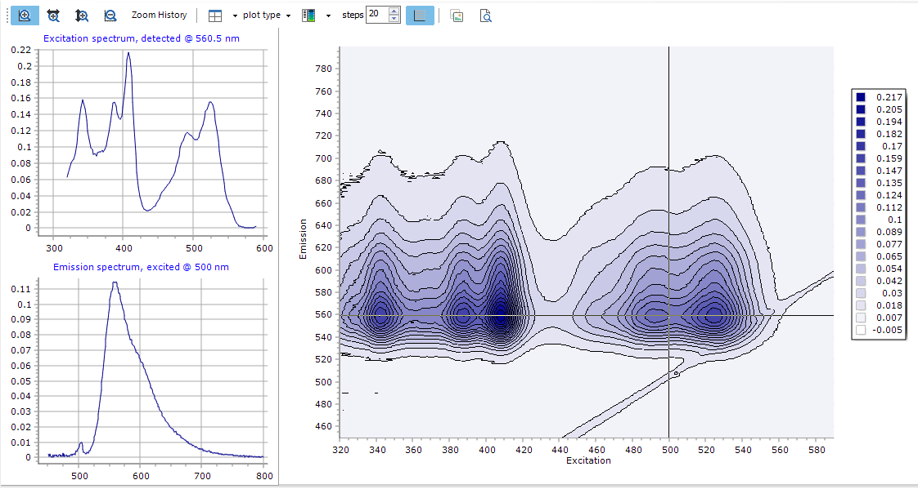
Features: Fluorescence/EEM
Correct emission sensitivity & excitation intensity
Assign excitation wavelengths
Remove 1st & 2nd order Rayleigh and Raman scatter
Subtract Blank datasets from EEM matrix
Calculate excitation spectra
Show:
2D & 3D EEM plots
with Ex & Em
cross-sections
© 2019: Dr. Friedrich Menges Software-Entwicklung. Friedrich.menges@effemm2.de Web: http://spectroscopy.ninja All rights reserved.

Slide 31
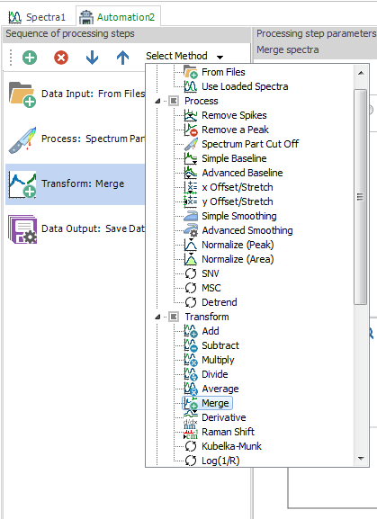
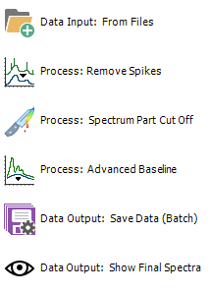
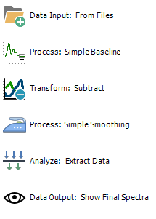
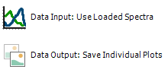
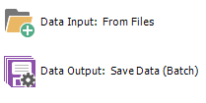
Features: Automate
Define sequences of processing steps
Select from 45 possible steps
Save sequence for further use
Execute sequence on loaded spectra
Execute sequence w/o showing spectra
Turn live processing on/off
Interrupt sequence execution
With processing protocol
Examples:
Plot creation
Batch export
Raman processing
UV-VIS kinetics
© 2019: Dr. Friedrich Menges Software-Entwicklung. Friedrich.menges@effemm2.de Web: http://spectroscopy.ninja All rights reserved.

Slide 32
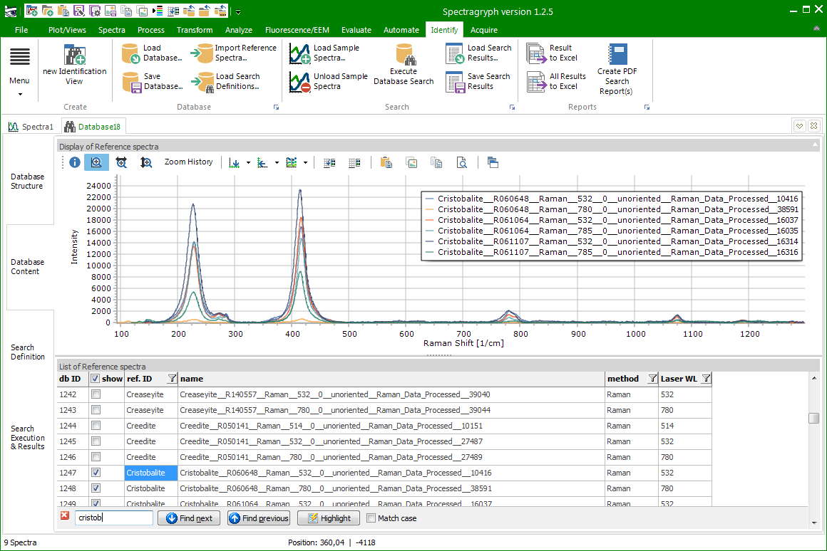
Features: Identify(database creation)
Create custom databases from all recognized file formats
Import commercial databases in OMNIC *.lbd/lbt format
Define descriptors and descriptor values as meta data
Define search & matching algorithms, combine search results with weighted
hit values
Filter searched entries
by technique and des-
criptor values
Multi-technique libraries,
identified with sample ID
© 2019: Dr. Friedrich Menges Software-Entwicklung. Friedrich.menges@effemm2.de Web: http://spectroscopy.ninja All rights reserved.

Slide 33
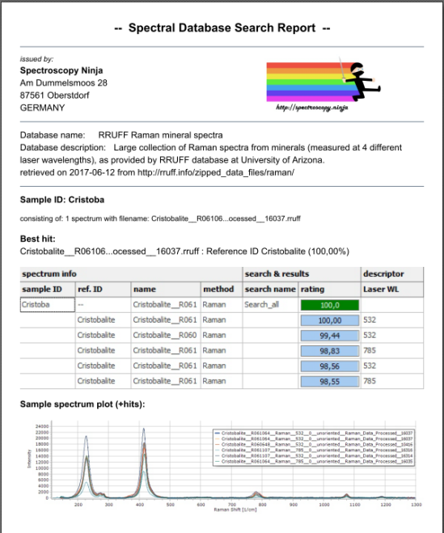
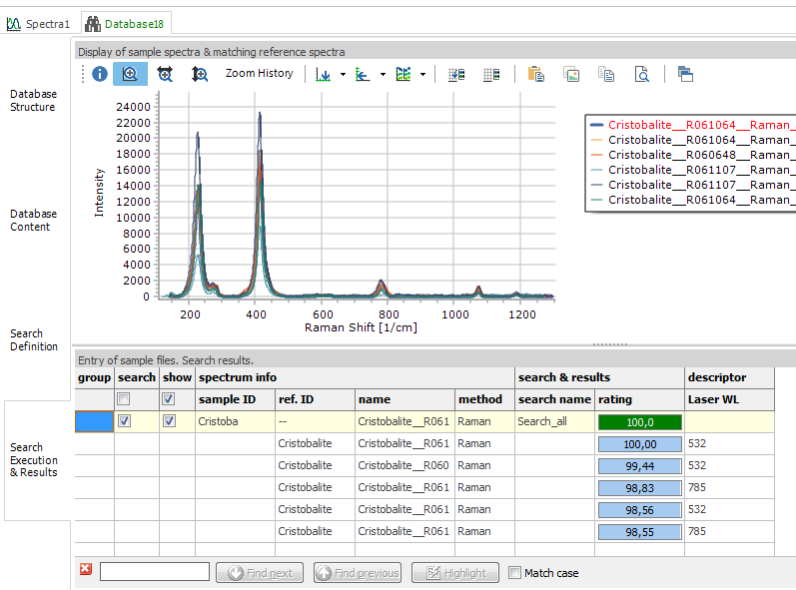
Features: Identify (search results)
Search multiple sample spectra at once
Display search results as sorted hit list
Customize number of displayed hits
Display search result as spectra, use
for further processing
Save & load
previous search results
Export results to Excel
Create & save customizable
PDF search report
© 2019: Dr. Friedrich Menges Software-Entwicklung. Friedrich.menges@effemm2.de Web: http://spectroscopy.ninja All rights reserved.

Slide 34

Features: Acquire
Connect to a range of spectrometers
(multi-channel mode possible)
Set acquisition parameters (exp. time,
averaging, dark subtr.)
Set acquisition mode (single shot, cont.,
additive, burst, loop)
Set measurement mode (intensity, trans-
mittance, reflectance, absorbance)
X axis calibration
Eight on-the-fly post-processing steps
Save & load device-specific settings
Save spectral data on-the-fly
© 2019: Dr. Friedrich Menges Software-Entwicklung. Friedrich.menges@effemm2.de Web: http://spectroscopy.ninja All rights reserved.

Slide 35
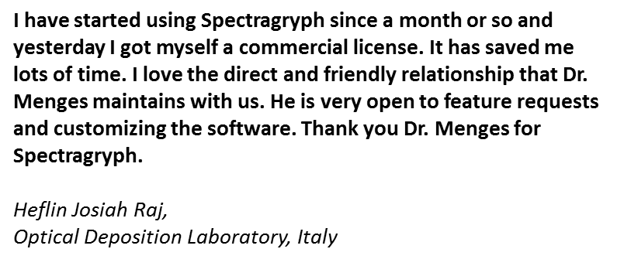
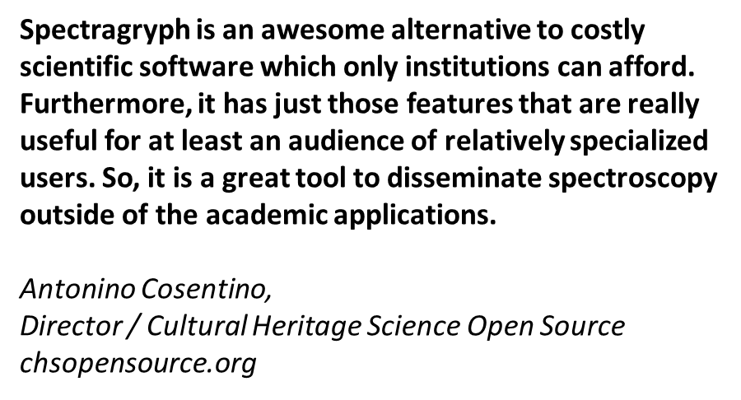
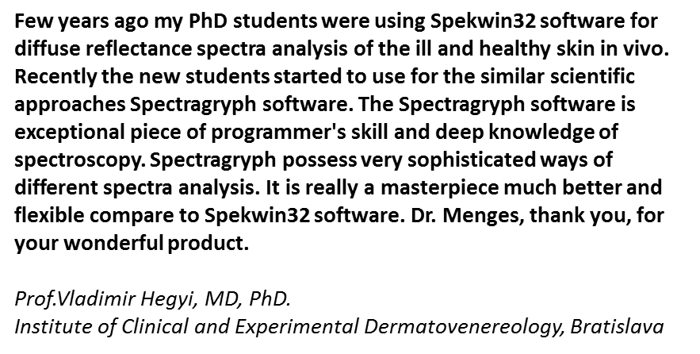






Some Testimonials
© 2019: Dr. Friedrich Menges Software-Entwicklung. Friedrich.menges@effemm2.de Web: http://spectroscopy.ninja All rights reserved.

Slide 36










Even more testimonials
© 2019: Dr. Friedrich Menges Software-Entwicklung. Friedrich.menges@effemm2.de Web: http://spectroscopy.ninja All rights reserved.

Slide 37
Links
Linkedin: http://de.linkedin.com/in/friedrichmenges
Facebook: https://www.facebook.com/Spectroscopy.Ninja/
Twitter: https://twitter.com/MengesFriedrich
Youtube: https://www.youtube.com/channel/UCpjrKBe7m_Exf6-zRPIeJjw
Website: http://Spectragryph.com
  Features: https://www.effemm2.de/spectragryph/about_feat.html
  User testimonials: https://www.effemm2.de/spectragryph/testimonials.html
  Help: https://www.effemm2.de/spectragryph/about_help.html
  Purchase: https://www.effemm2.de/spectragryph/license.html
© 2019: Dr. Friedrich Menges Software-Entwicklung. Friedrich.menges@effemm2.de Web: http://spectroscopy.ninja All rights reserved.

Slide 38
Applications
In heavy use by academics all over the world for
  Conversion of original, binary file formats into something readable
  General purpose spectral data processing for all kind of spectra from UV-VIS, NIR, FTIR, Raman, fluorescence,
  LIBS, XRF spectrometers
  Freeing up instrument time by allowing researchers to treat their spectra wherever and whenever they need
  Generating plots for posters, papers, daily work
  Visualize, overlay and compare spectra in ways that were not possible before
  Teaching practical spectroscopy to countless students
© 2019: Dr. Friedrich Menges Software-Entwicklung. Friedrich.menges@effemm2.de Web: http://spectroscopy.ninja All rights reserved.

Slide 39
Special Applications I
With the „Automate“ feature, take the dumb, repetitive, error-prone aspects out of spectra processing.
  Example:
  A user is taking 100,000s of LIBS spectra within a quantitative measurement campaign. Data reduction includes baseline sub-traction, averaging, merging and peak area analysis. By putting all these steps into a Processing sequence, data reduction becomes 100% reproducible and takes only little time. No more need to save intermediate steps. Also, several calculation approaches can be easily compared from the final results. The best sequence is kept in the end and can be applied ever and ever again on arbi-trary numbers of spectra.
© 2019: Dr. Friedrich Menges Software-Entwicklung. Friedrich.menges@effemm2.de Web: http://spectroscopy.ninja All rights reserved.

Slide 40

Special Applications II
With Spectragryph-id-on, and using the right spectral libraries, material identification is only two clicks away
  Example:
  Spectragryph-id-on controlling an Andor camera based Raman system, with the RRUFF mineral Raman database loaded into a „Identify“ tab. The little yellow fork truck carries the data from the acquisition tab to the identification tab, so it takes only two clicks from measurement to search result.
  Watch this video: https://youtu.be/QPYunSwUTS4
© 2019: Dr. Friedrich Menges Software-Entwicklung. Friedrich.menges@effemm2.de Web: http://spectroscopy.ninja All rights reserved.

